Slide 1
Capstone Project - AllianceBernstein
Weekly Update
4.3
Hongyu Dai

Slide 2
Summary - TX data
Checked and re-merged the dataset
Fixed the target variable to median_ppsf change percentage compared to last year
EDA
Checked for missing values and -1
Model (Using data from 2022 as an example)
Statsmodel
Data Process
Continuous variables -> RandomForestRegressor
Convert to Discrete variables? -> RandomForestClassifier
Feature selection
Linear regression
Will check assumptions of linear regression

Slide 3
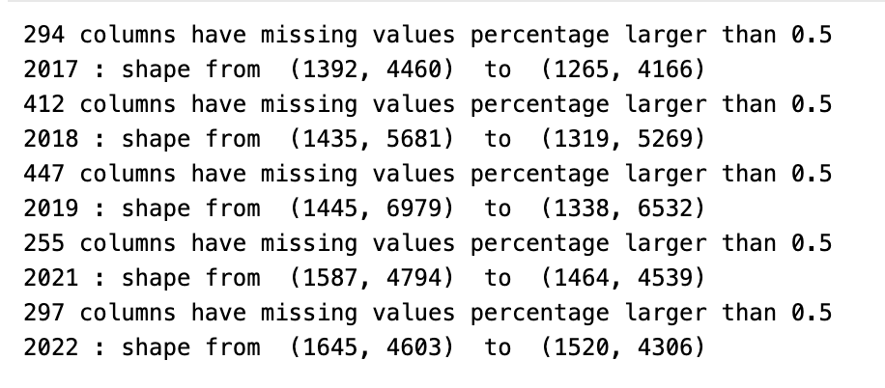
EDA
The data itself has a large number of . values -> treats it as NaN when read data in Python
In addition to the regular values, there are many -1
The meaning of -1 is not clear
Preliminary data processing
Drop column where >50% columns are null
Drop rows where >50% columns are null
Dropped 1/15th of the column. There are still 4000 factors

Slide 4
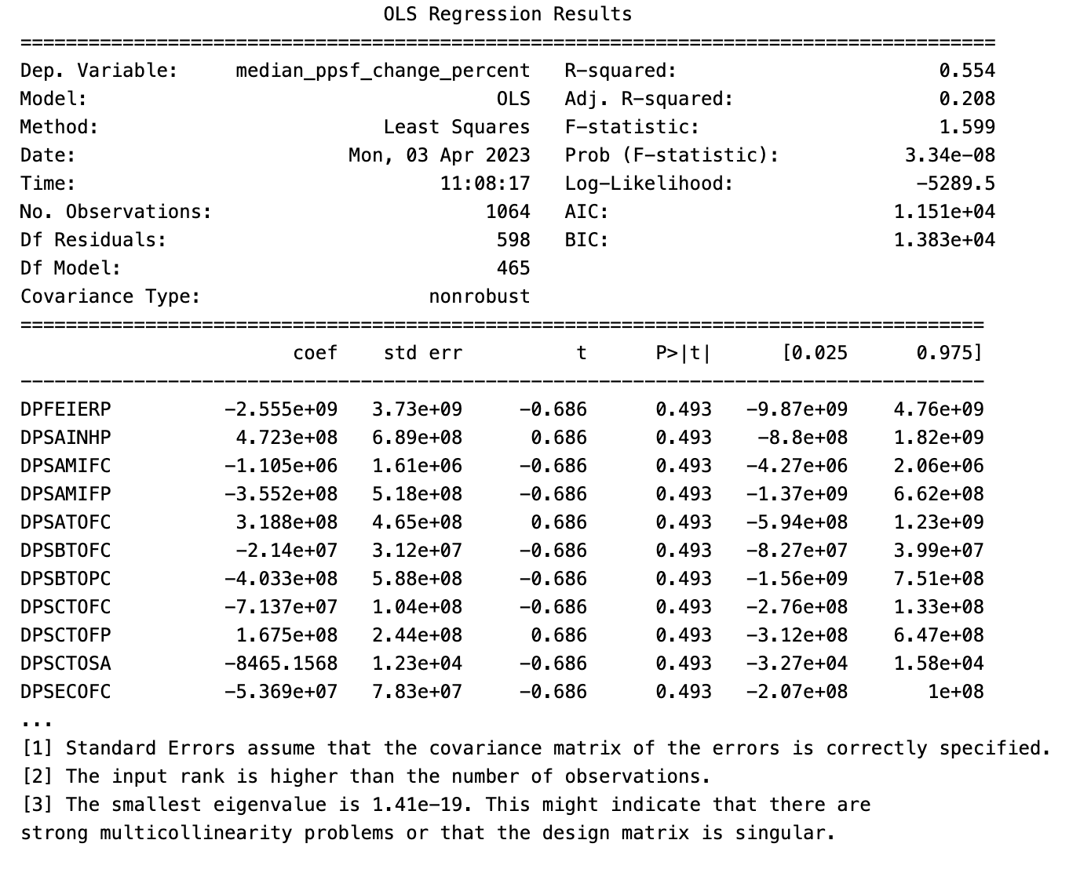
Statsmodel

Slide 5
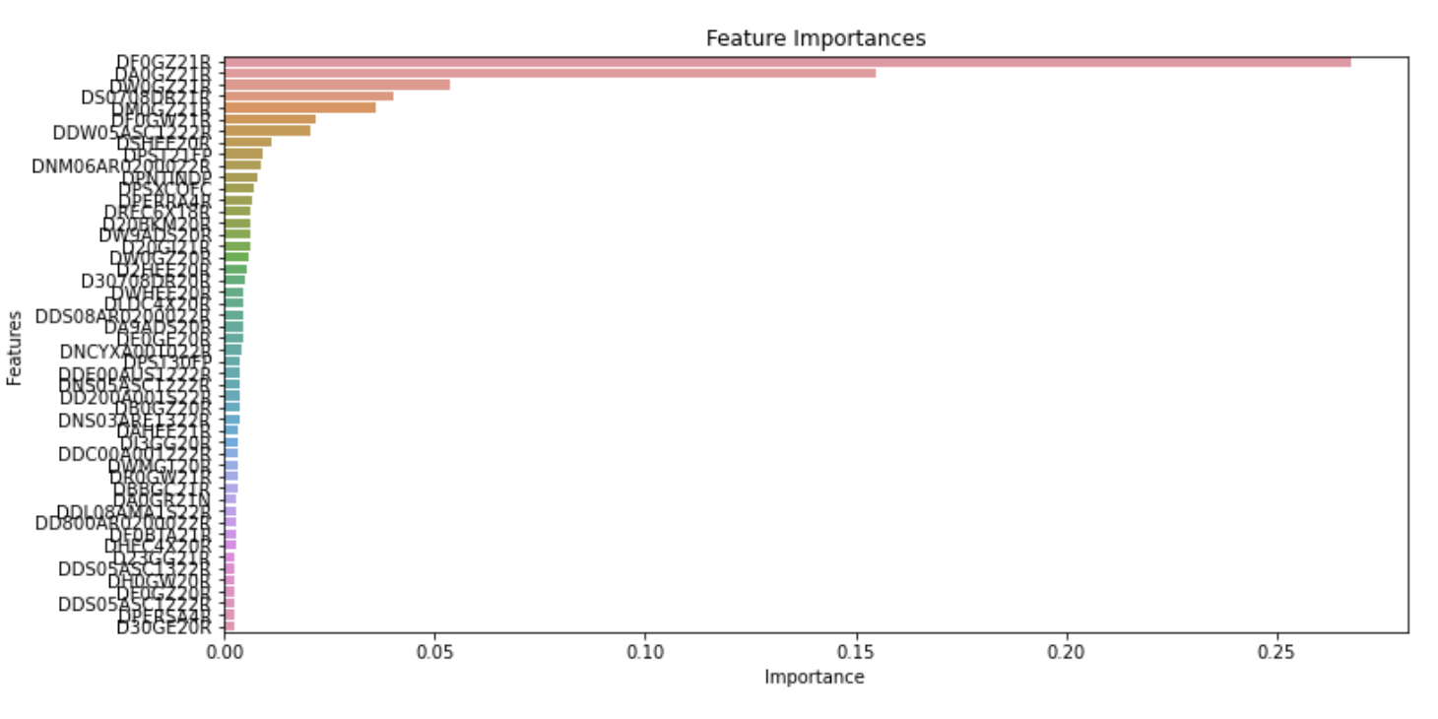
Feature Selection
Using RandomForestRegressor
Select the 50 most important variables

Slide 6
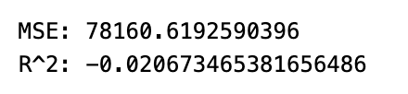
Linear regression - Continuous
Using the 50 most important variables obtained from last step
LinearRegression
Calaulate MSE and R^2

Slide 7
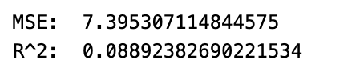
Linear regression - Discrete
Uniform scaling of data to (1,10)
Convert to category variables
Top 25 importance feature
Notes:
the MSE value of 7.566171633398244 indicates that on average, the predicted values are about 2.75 units away from the actual values (since the square root of MSE is approximately 2.75). A lower MSE value generally indicates a better fit of the model to the data.
the R^2 value of 0.06787391115637775 indicates that only about 6.8% of the variance in the dependent variable (Y) can be explained by the independent variables (X). A higher R^2 value generally indicates a better fit of the model to the data.

Slide 8
Next Step
TX Data
Checking the Linear Regression Assumptions
No Multicollinearity
Mean of residuals should be 0
No Heteroskedasticity
Linearity of variables
Normality of error terms
CA Data
Code Documentation: Document the code to make it easier to understand and maintain.
Build Pipeline: Create a build pipeline to automate the process of building and testing the code.

